Slide 1




HackOrbit 2025
HACKBOTS

Slide 2

PROBLEM STATEMENT
THEME & PROBLEM STATEMENT
HEALTHCARE
MED-SYNC
In today's healthcare ecosystem, there is a significant gap between initial doctor consultation and continuous care, leading to improper medication, poor diet compliance, and delayed emergency response. Many patients forget their medicine timings, consume harmful medicinal drug , or fail to follow disease-specific diet instructions. Moreover, after emergencies or queries, there is often no immediate support, causing panic or delayed action. The current hospital systems lack an integrated and real-time patient-doctor interface that covers ongoing treatment, diet, and emergency handling

Slide 3
Proposed Solution
Our Smart Healthcare Portal addresses the need for efficient doctor-patient interaction through a comprehensive web-based solution. The hospital login system empowers doctors to securely manage patient records, track medicine dosages with automated reminders, generate detailed reports, and schedule checkup appointments. Patients, through their dedicated login, can access their medical records, view dosage schedules, consult doctors seamlessly via chat or video, and manage their checkup appointments with the diet and what are the things to be avoided during the treatment.

Slide 4
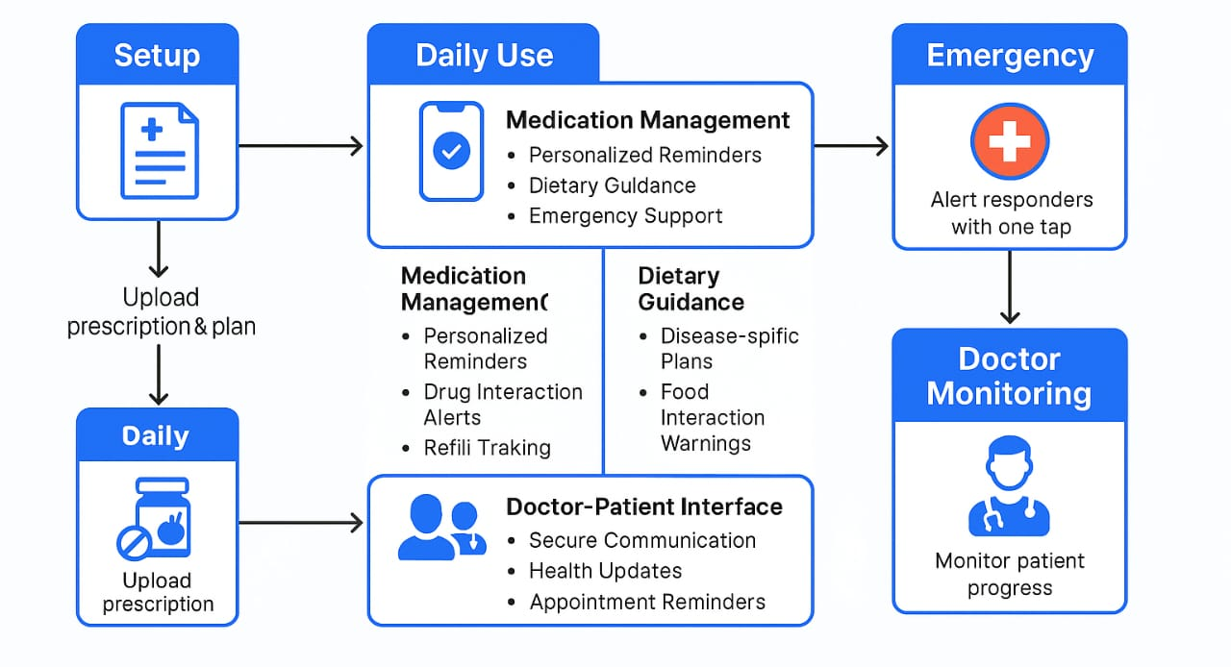

FLOWCHART / DIAGRAM
Dietary Guidance
Disease specific
plans
Management

Slide 5
FLOWCHART / DIAGRAM
Setup: After a consultation, the hospital uploads the patient’s prescription, diet plan, and health records into the website with the patient’s permission.
2. Daily Use: The Web-app becomes the patient’s daily health assistant. It reminds them to take medicines on time, follow a specific diet, and alerts them if any food or drug is unsafe. Patients can also upload their daily prescriptions, meals, or symptoms.
3. Doctor-Patient Interface: The web allows patients to message or video call their doctor for doubts. It can also send updates like blood pressure or sugar levels (manually or from a device) so doctors can track progress without needing a visit.
4. Doctor Monitoring: Doctors can check the website for updates about the patient’s condition and adjust treatment as needed remotely.

Slide 6
FEATURES AND NOVELTY
Login & Health Records: Commonly available in most healthcare websites.
Medicine Reminders: Widely implemented as a basic feature.
Disease-Specific Medicine Safety: Rarely seen; the concept of checking drug compatibility based on the patient’s condition is novel.
Disease-Based Diet and Food Intake Plans: Rare feature; diet plans tailored to specific conditions are innovative.
Instant Emergency Assistant: Not commonly offered in general healthcare website; adds real-time value.
Emergency Hospital Route with Medical Data: Unique combination of navigation and sharing patient history in emergencies.
Integrated Smart AI Engine (Symptoms + Alerts): Most web-apps lack an AI that ties together symptoms, medication, and diet in one place.
Post-Consultation Patient Monitoring: Only partially implemented in some platforms; full integration with vitals tracking and doctor feedback is a novel approach.

Slide 7
DRAWBACK
Unreadable Doctor Handwriting: If prescriptions are handwritten and unclear, uploading or syncing accurate medicine/diet data into the app becomes difficult and error-prone.
Tech Literacy Gap: Elderly or non-tech-savvy users may struggle to use the Website effectively, even with a simple interface.
Data Privacy Concerns: Handling sensitive medical data requires strong encryption and privacy safeguards, which can be challenging to implement.
Limited Hospital Integration: Smaller clinics or rural hospitals might not have the digital infrastructure to upload prescriptions or health records directly.

Slide 8
HACK-BOTS
Name | Contact
Shivam Sahu | shivamsahu0927y@gmail.com
Ragini Rathour | raginirathour1025@gmail.com
Leena Chandrakar | leenachandrakar78@gmail.com
Roshan Chandraker | roshanchandraker286@gmail.com

Slide 9
Thank you

